Slide 1
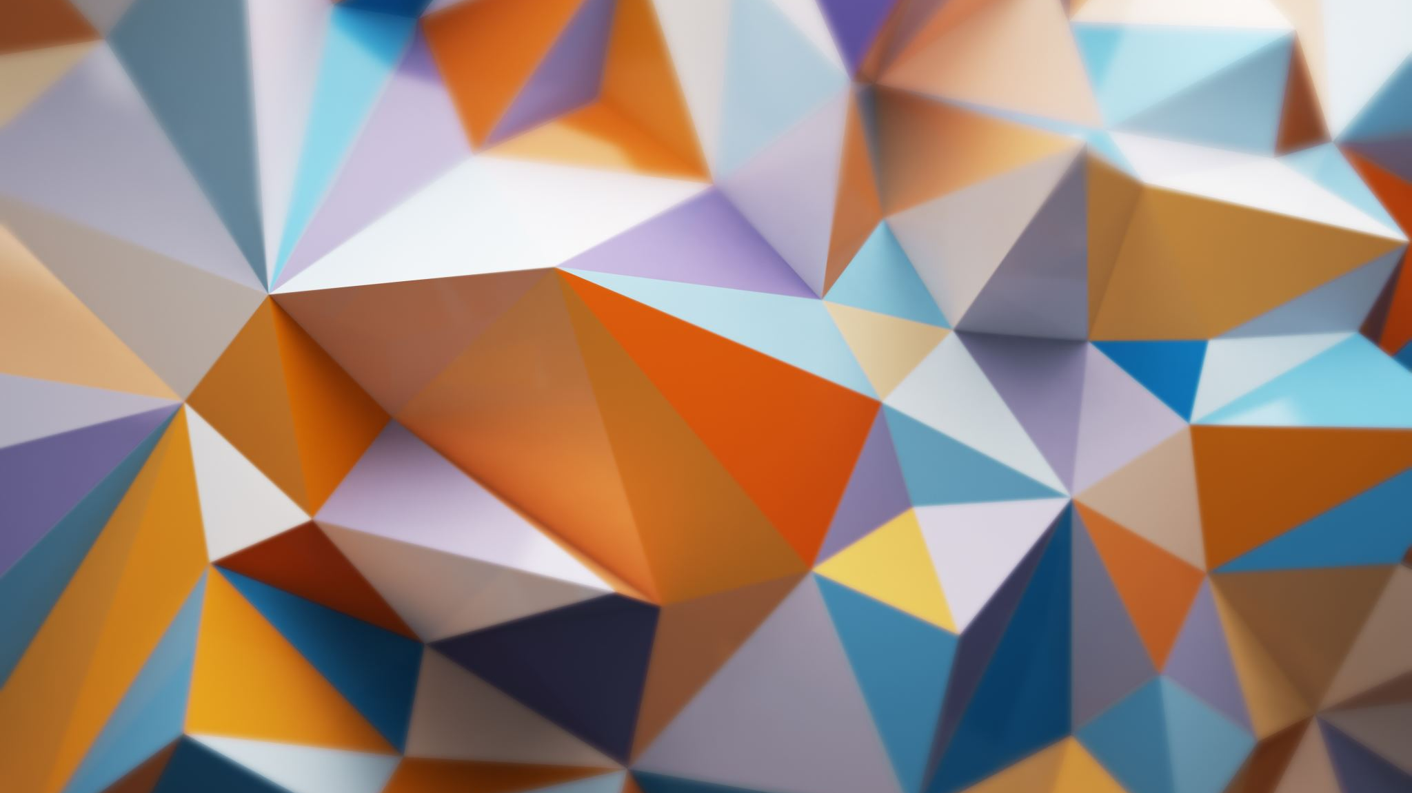
my diabetes
Juan Camilo Madero

Slide 2
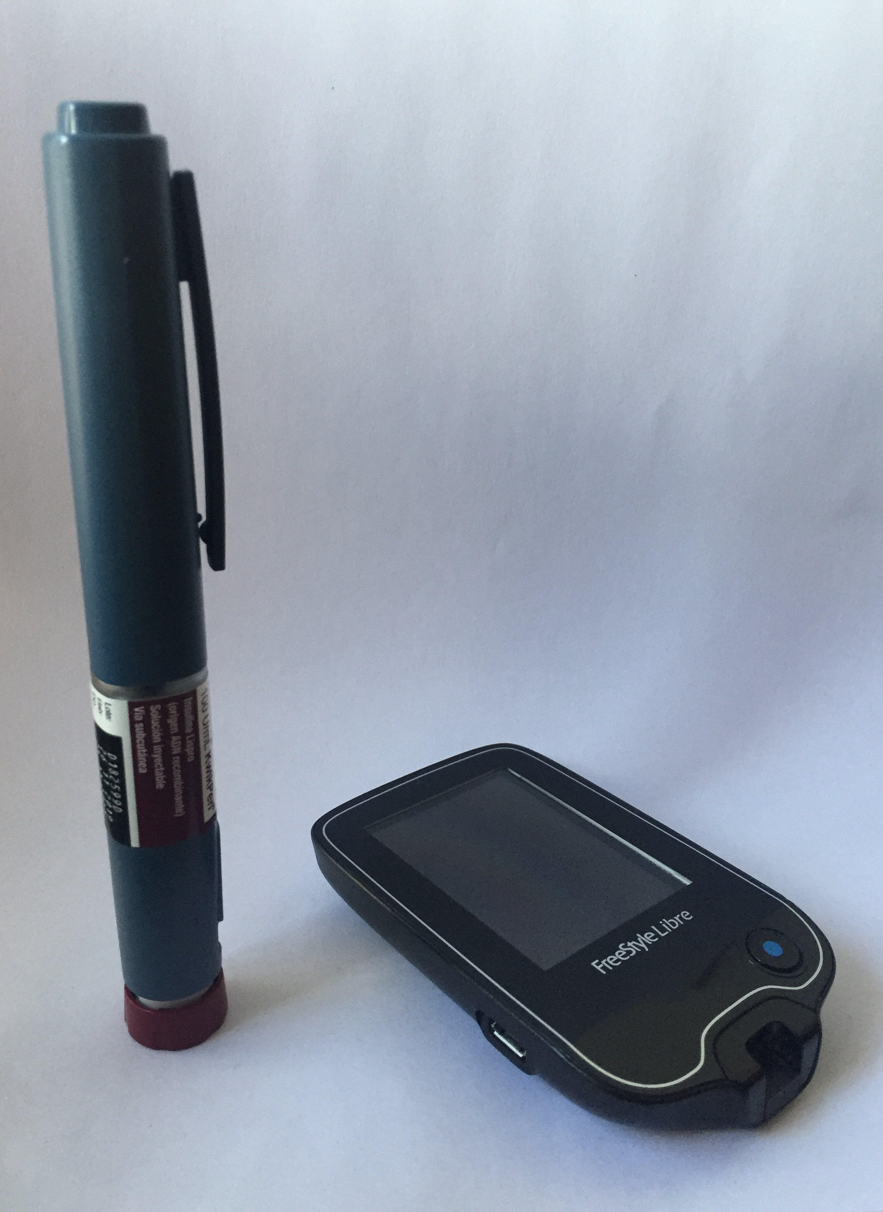
What’s the project idea?
My project will be around my diabetes. The objective is to portrait my expierence around my condition and express to the public how I felt and how I was hopeful of what could be of me following certain things, to live without any risks. To show it, I will use archival material such as the hundreds of medical appointments sheets and the tools i use to anage my diabetes, to create a hospital room, which is what I most remember of my pre´diagnososis of diabetes.

Slide 3
Reference i
Pepon Osorio
In Pepon’s art, he intervenes a space, which in this case is a room covering the walls with papers and pictures which set the scenario recreated. That is why he is my archival reference. From the image shown of his exhibition, the images that he makes and covers the wall, as well as the concept of archival which I’m working in my work- Finally the placement of different objects around the space its interesting to use as reference for my own work.

Slide 4
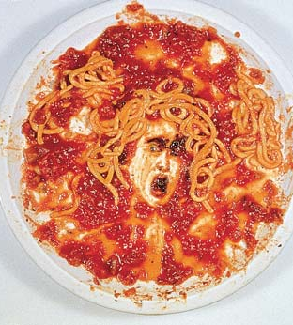
Reference ii
Vik Muniz
In Muniz paintings he uses non-conventional materials to recreate images or in my case silhouettes. He is my reference because he uses materials to create images and paintings that in the image shown, is Medusa’s face with some spaghetti plate leftovers. As mentioned before, those non-conventional use of materials, Is why I chose Muniz as my reference. Also, the technique applied, is in a sort of way what I want to do for my personal project..

Slide 5
Explained sketch
Pepon Osorio which is my archival reference is connected to my project, because as we could see in the image shown before, he covers the walls of the space intervened and paste images that set the environment recreated. This is going to be evidenced in my final product, because I will intervene my room, covering my walls with the diagosis and tons of paper work of medical appointments and on the bed, I will create a shillouette with sugar, which makes me relate it with my other references, which is Vik Muniz. From him, is evident the use of non-conventional materials to create an image. The concepts that are evident are first of all archive, in the way I use that material I have around my diabetes and also transformation because what I can observe of Pepon is that he is talking about a transformation of

Slide 6
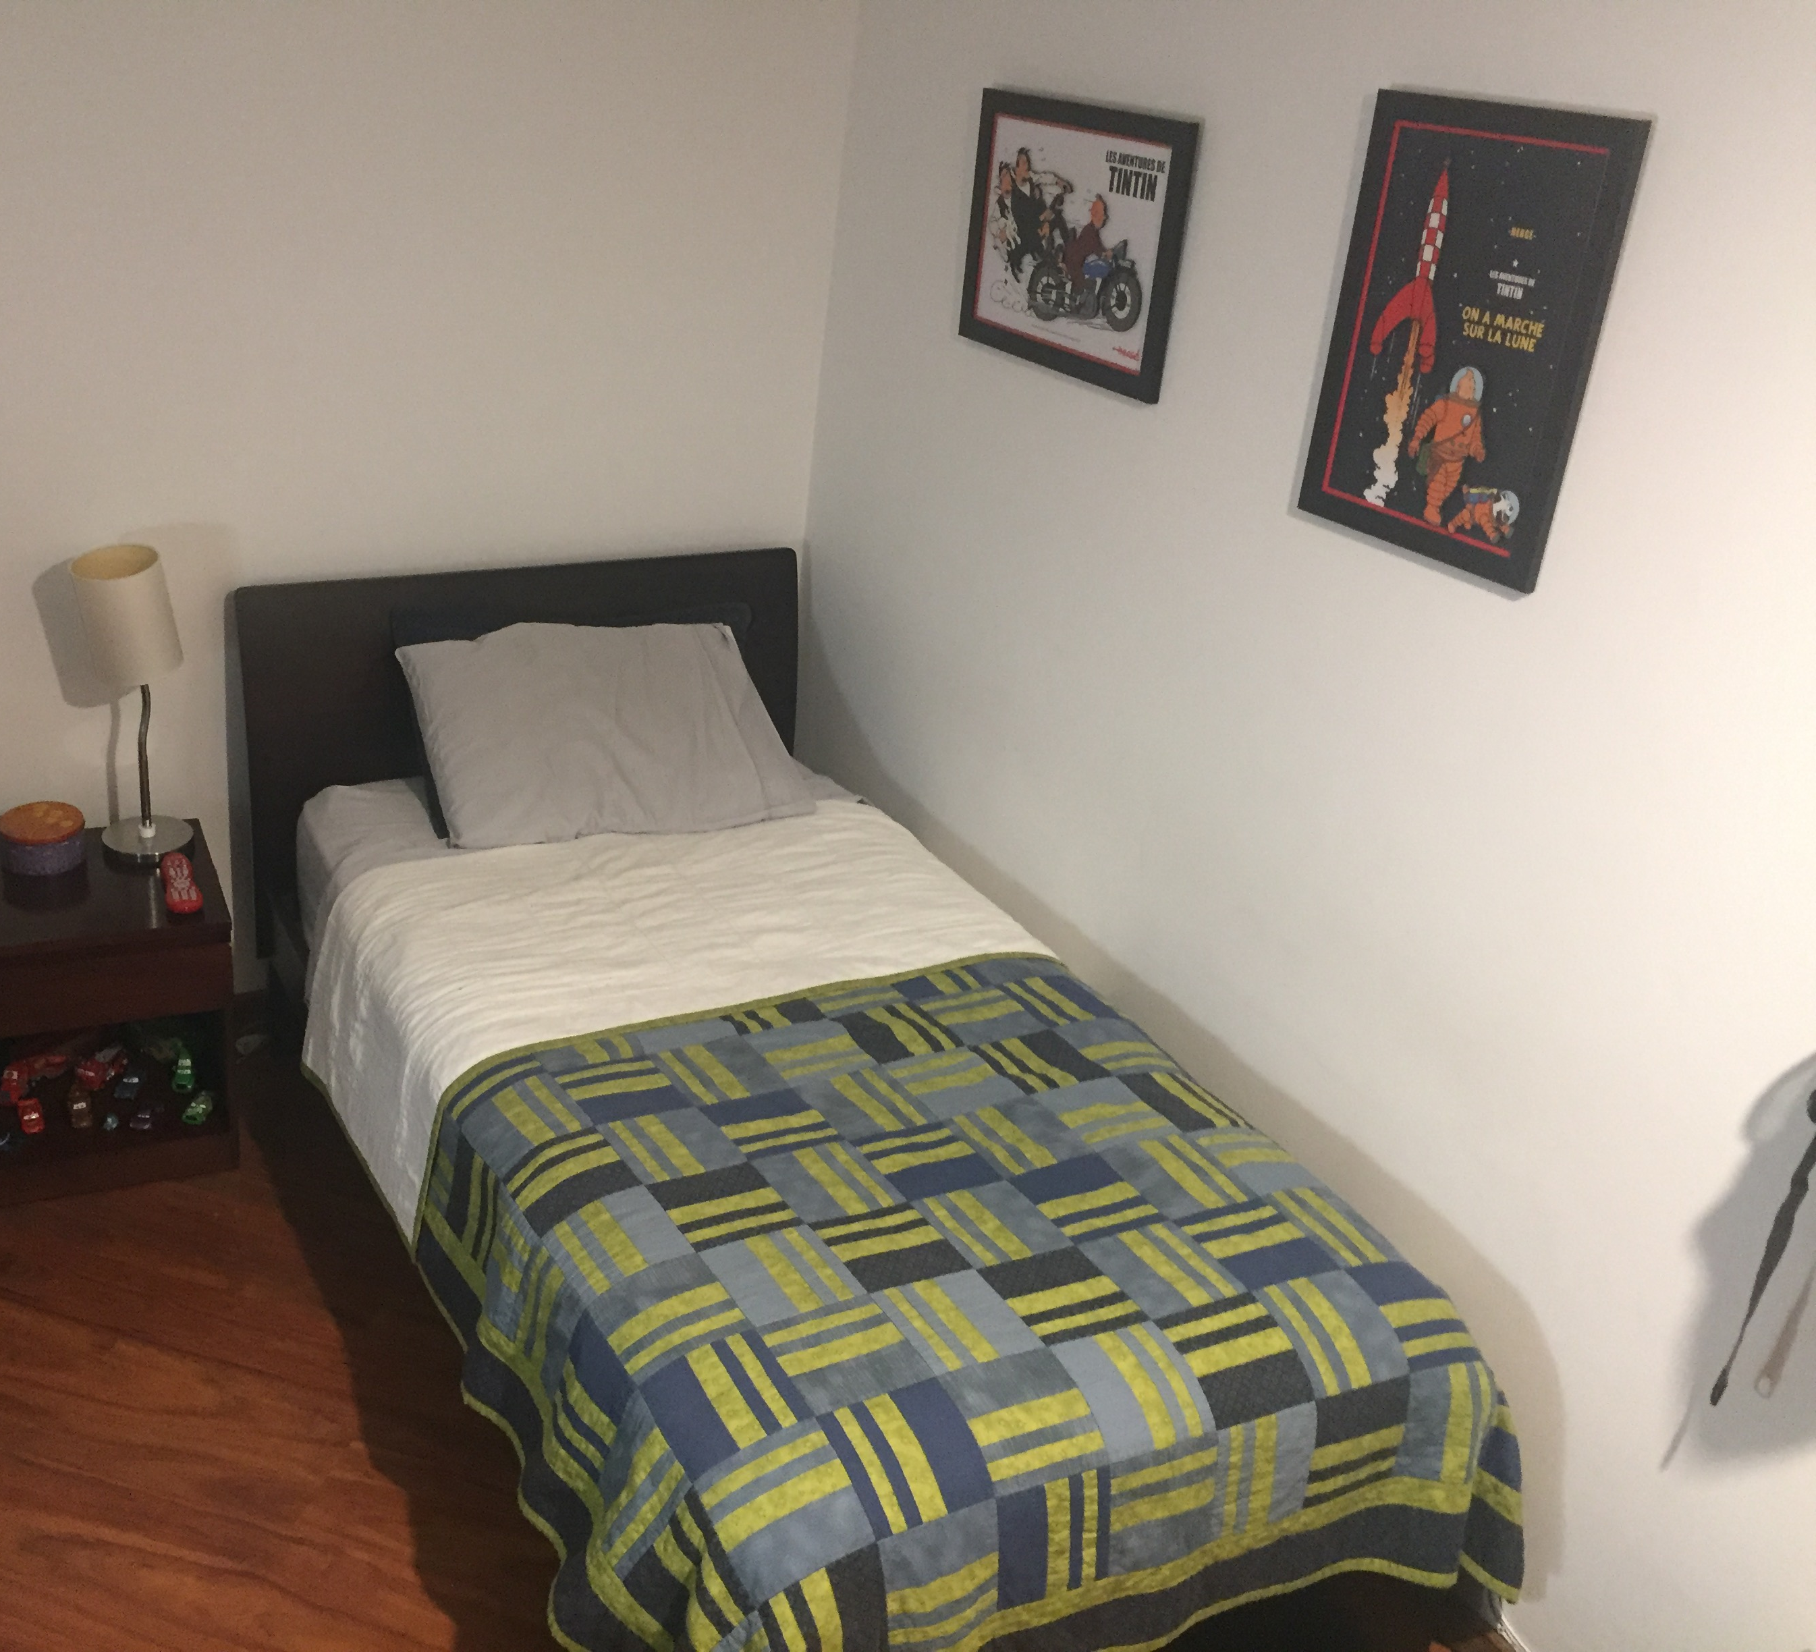
Curatorial sketch
The space I will use is my room, in the bed, I will create a silhouette of my body and make it with sugar, in the stomach, make the form of a pancreas of plasticine and attached to it nails which I apply my insulin with. Then, in both walls I will cover them with my diagnosis and medical appointment papers. Also, as I want to give that vibe to a hospital, I will place in the bed things that remember me it, like a stuffed bear that my teacher at that time gave me so it could be my partner throughout that tough time. Also, photos of my mother because she was the one who was with me all time and made me be hopeful of what will come next. And finally, put the other tools I have had use to regulate my blood sugar.

Slide 7
Why You Should Buy My Product

