Slide 1
shark tank: animal abuse
Juan camilo madero

Slide 2
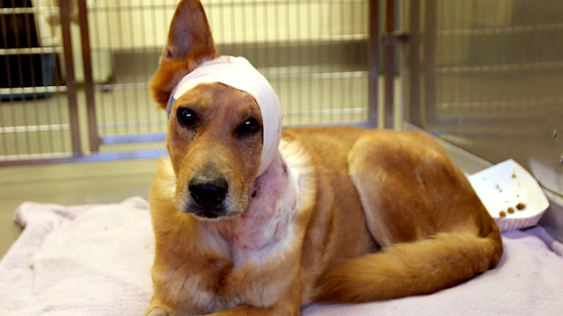
Objective
The objective of this project is to show the animal abuse and torture people do to them nowadays.
This image shows a dog found injure in the streets after his owner abused him.

Slide 3
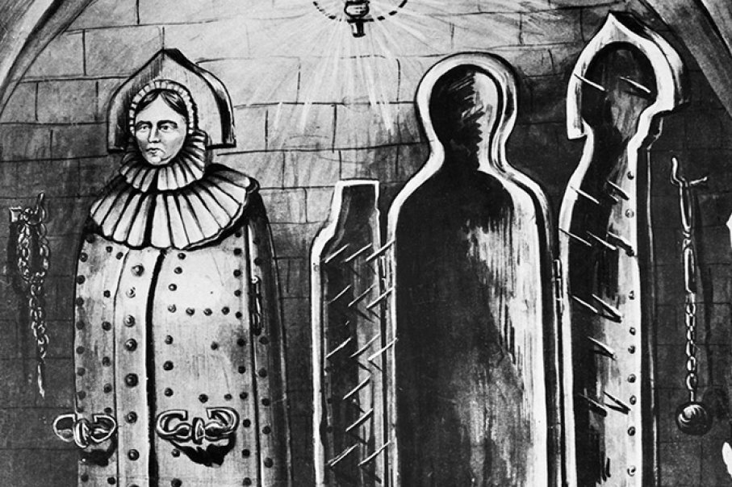
Project creation
The project will be done in a 3D sculpture in which taking into account the torture device in the Inquisition, called the Iron Maiden. It would be like it, but instead of a human shape, it would be a dog.
The 2D part of the project will be done with the inside material of the plush toys creating the form of an animal that has been abused
Both parts of the project are connected because they show the animal abuse because I show the torture in a non-conventional way to criticize that abuse animals get.

Slide 4
Refernece i
Vik Muniz
In Muniz paintings he uses non-conventional materials to create different things. He is my reference because he uses non-conventional materials to create a painting that in this case is made of a plate of spaghetti leftovers, that creates the face of Medusa.

Slide 5
Reference ii
Man Ray
In Ray’s art work he uses an object and he intervenes in it making his own appropriation and meaning of that object. He is my reference for the 3D model, because he intervenes this griddle by adding a line of iron spikes.

Slide 6
Materials
For the creation of this project I will need:
Scale size dog silhouette
Paperboard
Plush toys filling
Screws and/or nails

Slide 7
sketch

Slide 8
Space presented
In Gimnasio Campestre, there isn’t any adequate and visible space to present my project due to the fact that the only two animals in the school are in the entrance of the school buses and no one would notice my project. The space I will use instead, is the Patio de Banderas, because the flags are what represents the most what a gimnasiano is and the animal abuse is against what that term represents.

Slide 9
Why should you buy my project
I think you should my project because it shows the unacceptable animal abuse by appropriating a torture tool in the past, to represent that its almost the same as well of torturing a plush toy to represent that abuse.
Also, its a way of trying to generate conscience in the people, because as exaggerating the 3D model is, the things animals have to suffer are able to compare to this kind of torture. Basically, it’s to people to understand that any act that is to harm an animal it’s wrong.

